Slide 1
UNIT -
01
UX
Introduction
to
Design

Slide 2
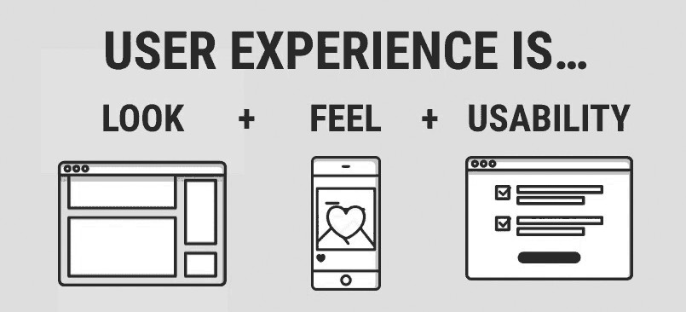
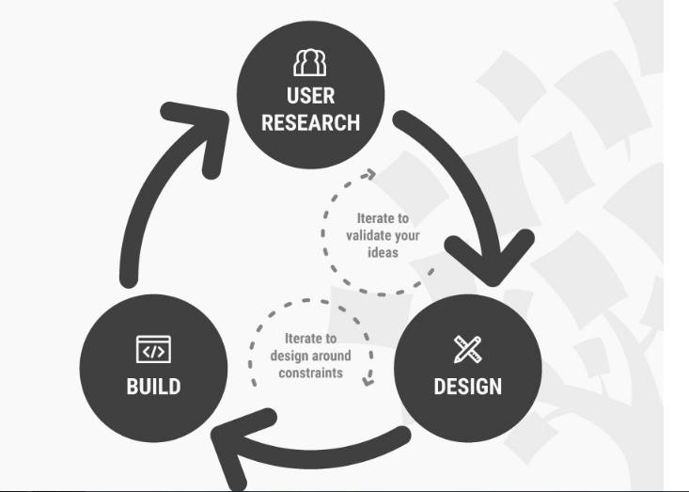
What is User Experience?
Look : visual appeal
Feel : a joy to use
Usability : reason to use
UXD is the process of creating products that provide meaningful and relevant experiences to users.
This involves the design of the entire process of acquiring and integrating the product, including aspects of branding, design, usability, and functionality
Iterative problem solving
UX design is a highly iterative problem-solving process, which can differ significantly from the practices familiar to graphic designers.

Slide 3
What is the Aim of UX Designs?
• The Aim is to design a product which we will be
able to use not only with a success but with joy.
• To Design a product that a user will wish to use it
again.
How
Does It Relate to Graphic Design?
• Graphic Design is an Integral Part of the concept of
a product.
• Thus it is an integral part of the User Experience
Design.
What is UX Design About After All?
• UX is not about aesthetics – its about
understanding users behavior and needs.
• UX Design is not UI – But UI is an Integral Part of
the UX Design process.
• It’s a design process concentrating on finding a
solution to make a product which people will enjoy using and won’t struggle and will want to use it again.

Slide 4
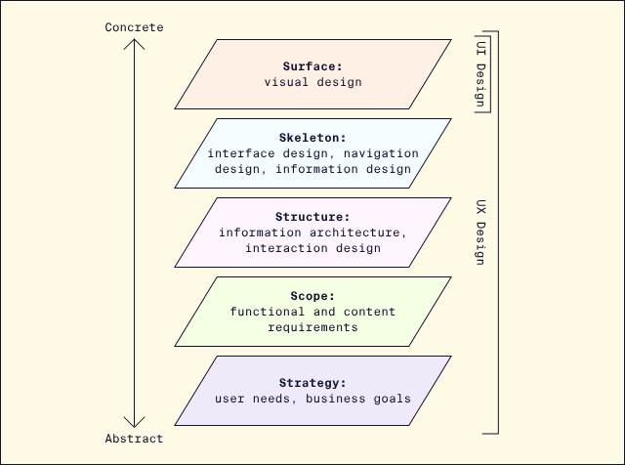

Slide 5
Strategy: What problem is this product intended to solve? This layer, the most abstract of the model, takes into consideration both user needs and business goals.
Scope: What is the product that will be created to solve the problem? Within this layer, the team defines functional requirements (what features to build) and content requirements (written and visual information to include).
Structure: How is the design organized and how do interactions work? This layer includes information architecture (the structure and organization of content) and interaction design (the interactive experience of the product).
Skeleton: How is information presented and arranged? This layer begins to consider UI design (design of interface elements), navigation design (how users move through a system), and information design (presenting information to facilitate understanding). A common output at this stage is a set of wireframes.
Surface: How does the product look and feel to users? This stage emphasizes visual design, for example, what colors and typefaces are used, and is the stage where UI design is front and center (though it is not exclusive to the surface).

Slide 6
Example:
Strategy: For example, let’s say we’ve been hired to build an app that helps people find charging stations for electric cars. On the one hand, we must be sure to meet the product objectives, which in this case would be goals such as, “Informing electric car owners of the nearest place to charge their cars”.
On the other hand, we need to meet user needs if we want users to come to our app for information.
Scope: in our car charger finding app, on the functional specifications side we might want to include a feature to save previously discovered charging stations in our functional specifications. Meanwhile, in our content requirements we might list information like images of each charging station, maps of their locations, and details about the voltage of each available charger.
Structure: For example, to convey the structure of our electric car charger finder app, we might create a site map that shows the hierarchy of the product. This could include a home page where users can enter a location to find car charging stations. This could then lead to a list of stations each with a link that takes users to pages for individual stations.
In addition, we could also create a user flow where we show how the system responds after a user enters their location information. It can account for what happens if the system finds nearby charging stations and if there’s an error that prevents the system from successfully understanding the location information provided.

Slide 7
Skeleton: in our app, if we want to explain what users will see when they navigate to a page that describes a specific electric car charging station, we would create a wireframe that provides a blueprint of where each component of the page would go.
Perhaps we have a header with the app logo and navigation back to the complete list of stations. This will be followed by an image of the charging station, followed by a link to a map of the location followed by text providing practical information about the station. This will help visualise each piece of functionality and content that will appear on the page and its placement.
Surface: For our electric car charging app, this could mean creating a consistent colour palette and layout, where the logo appears at the top of the page, the most important information appears in a wide column in the middle of the page, and less important information is relegated to each side of the page. This layout anchors users with its consistent visual style while enabling them to easily find the information they’re seeking.

Slide 8
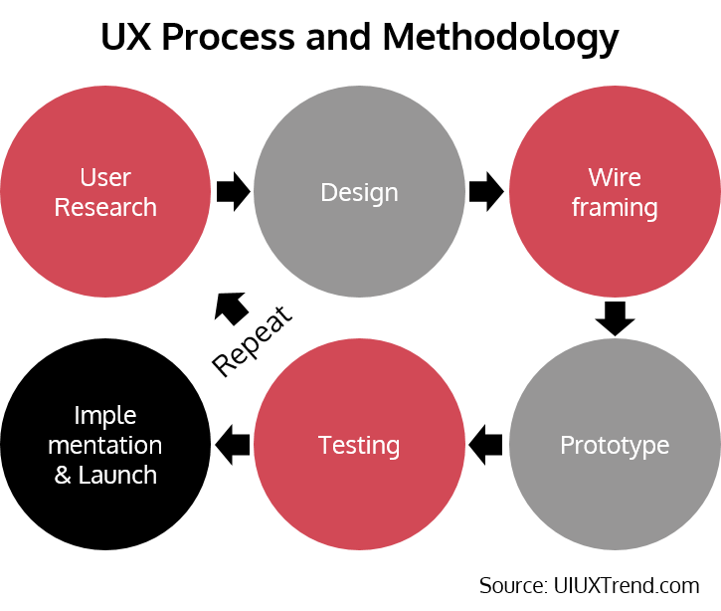
User Experience (UX) Process and Methodology

Slide 9
2.Ubiquitous
Interaction

Slide 10
• Usability and user experience relate to how well a
product (or service) is designed, but there are
subtle and important distinctions between them.
- Usability is about ease of use: a highly
usable product enables the user to achieve their
goals quickly, with minimum frustration
without error
and
- Usability is
Experience
an integral part of User

Slide 11
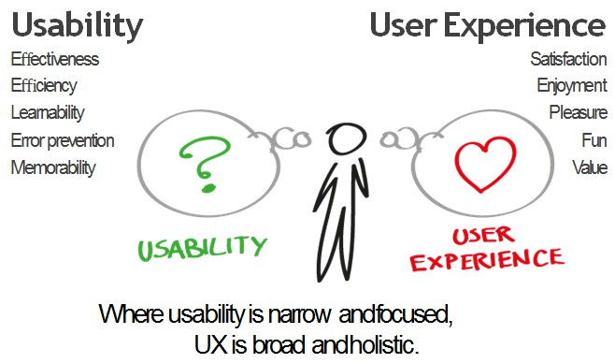
UX
vs.
Usability

